Slide 1
SMS Spam Blocker
Presented By: Ibrahim Irfan Bilal Ahmed

Slide 2
Outline
Introduction
Problem Statement
Scope
Proposed Solution
What We Have Done So Far
Future Work

Slide 3
Introduction
SMS spamming application is a project that will facilitate the prevention of unwanted SMS messages or pop up ads to appear on a user’s Android smartphone.
Users will be able to download a free of cost app from the Play Store that will allow them to avoid unwanted messages or spams and block any ads that can harm their device.

Slide 4
Problem Statement
For quite some time now, many individuals all around the world do most of their work on their Android smartphones and have become very fond of the technology.
In the modern era, most users keep all their data such as contacts, messages, accounts (usernames and passwords), and images on their Android device.
However, recently a lot of smartphone users have had to deal with the frustration of unwanted SMSs, spams and pop ads interfering in their work.
Most people don’t even know the origin of these spams and what harm they may bring. These spams are not only irritating but can also harm your device in many ways.

Slide 5
Scope
The scope of this project is to develop and design an Android based app that will be able to scan and detect SMS spams stored on a user’s Android smartphone and will provide the results

Slide 6
Proposed solution
In order to counter this issue, we came up with the idea to develop and Android App that will help users to keep their data safe from spams that may seem suspicious and harmful.

Slide 7
What we have Done so far
Data Collection
Data Compilation
Classification in Random Forest and SVM
Logistic Regression and Naïve Baise
GUI Design

Slide 8
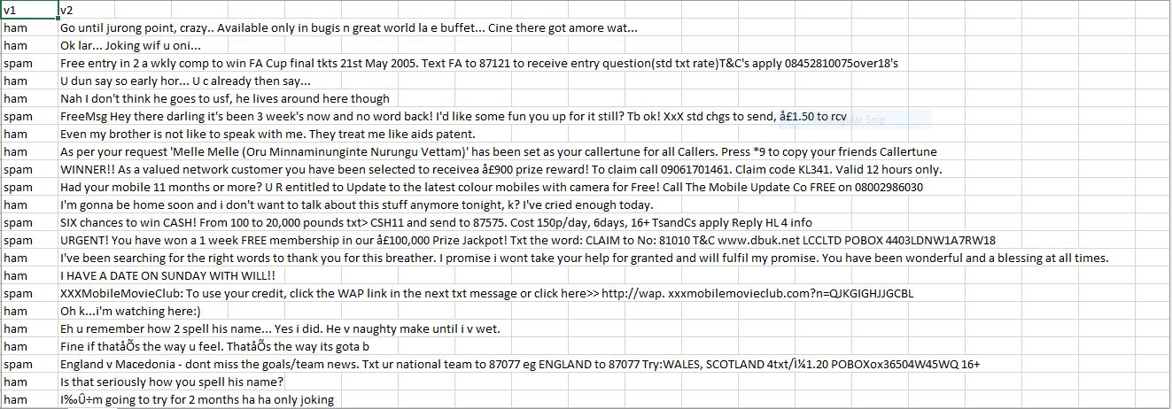

Slide 9
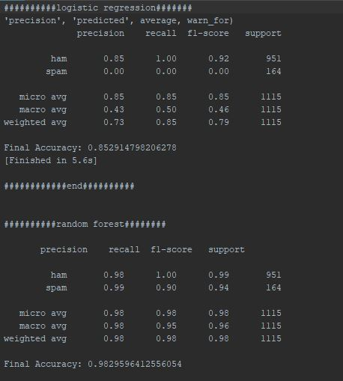
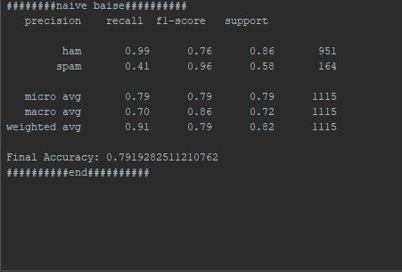

Slide 10
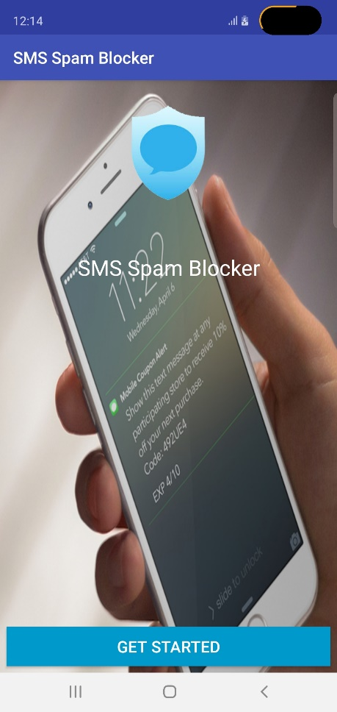

Slide 11
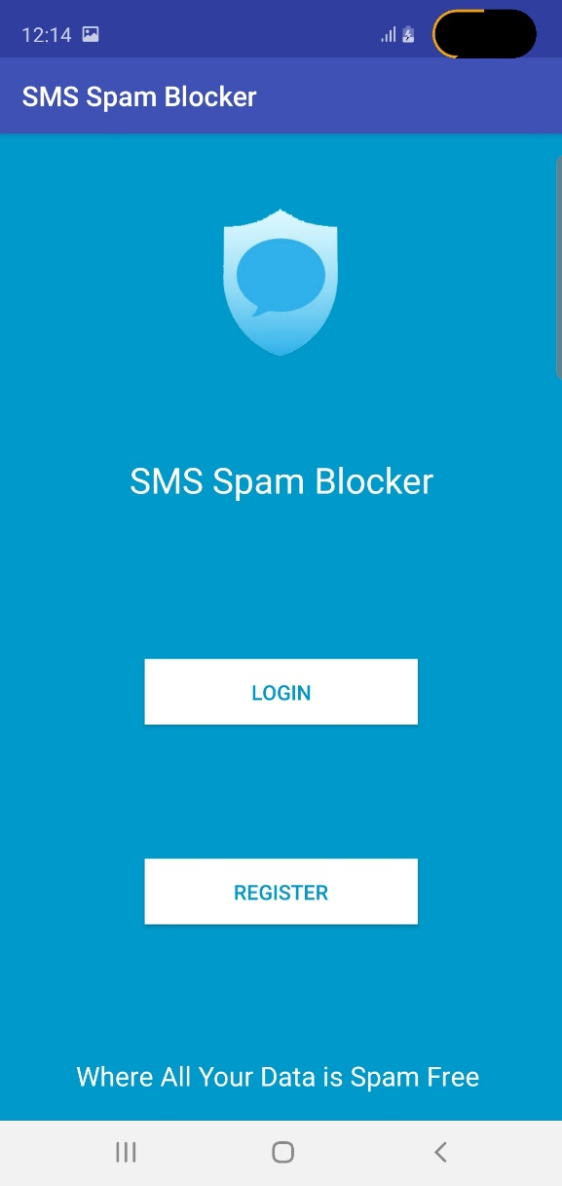

Slide 12
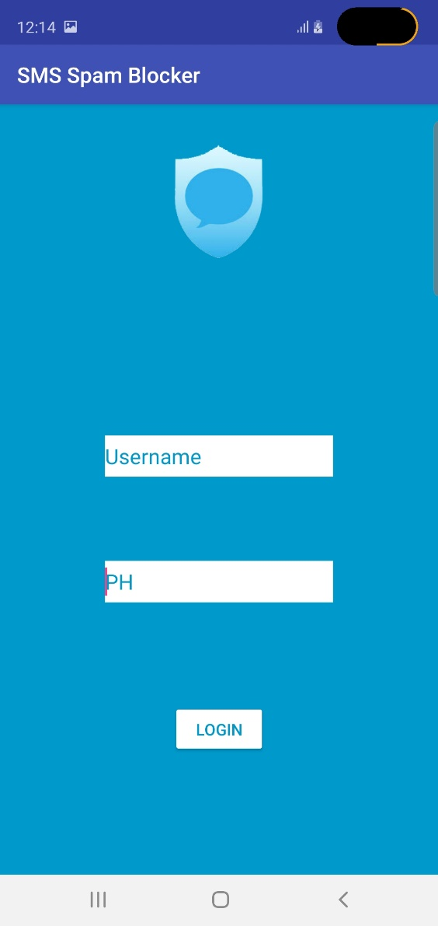
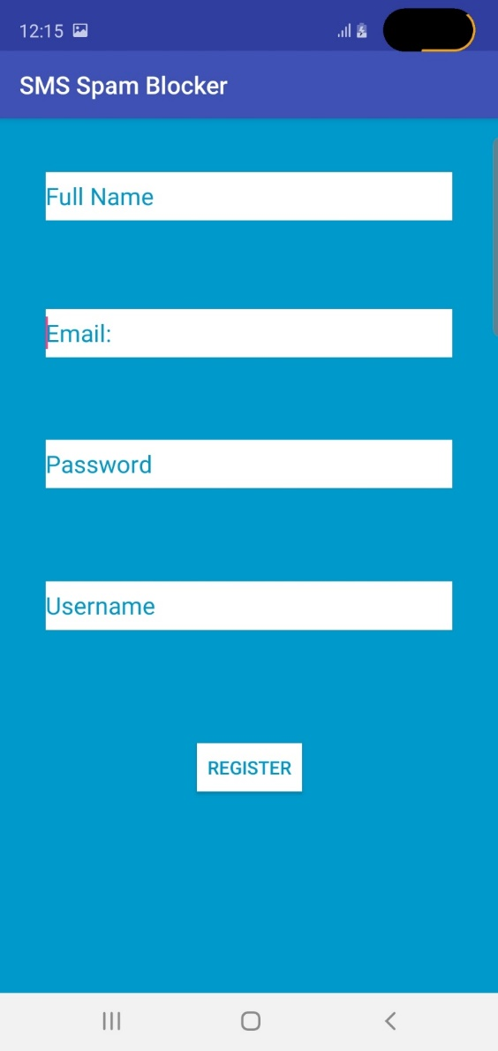

Slide 13
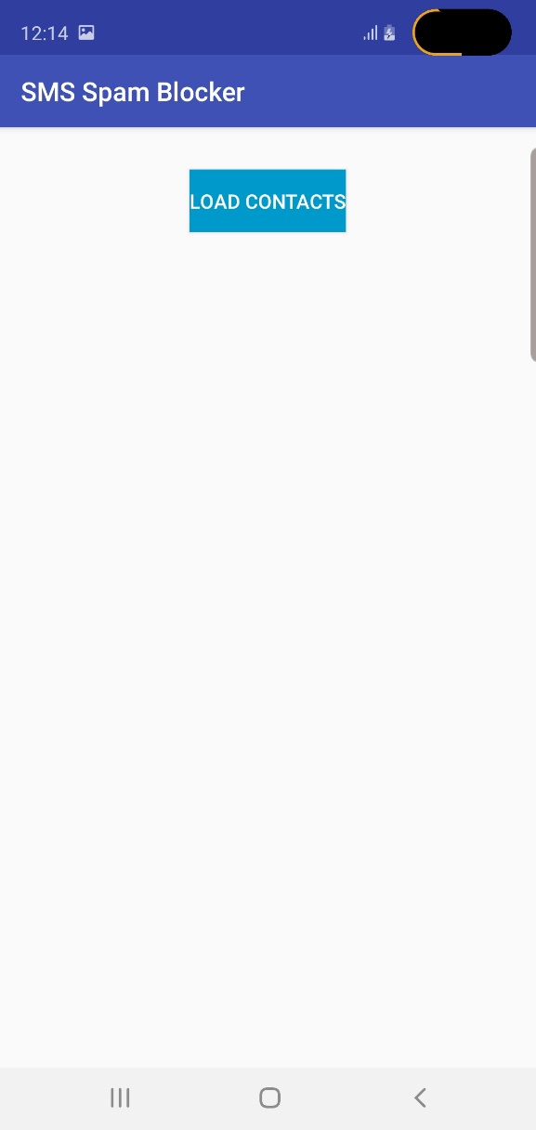
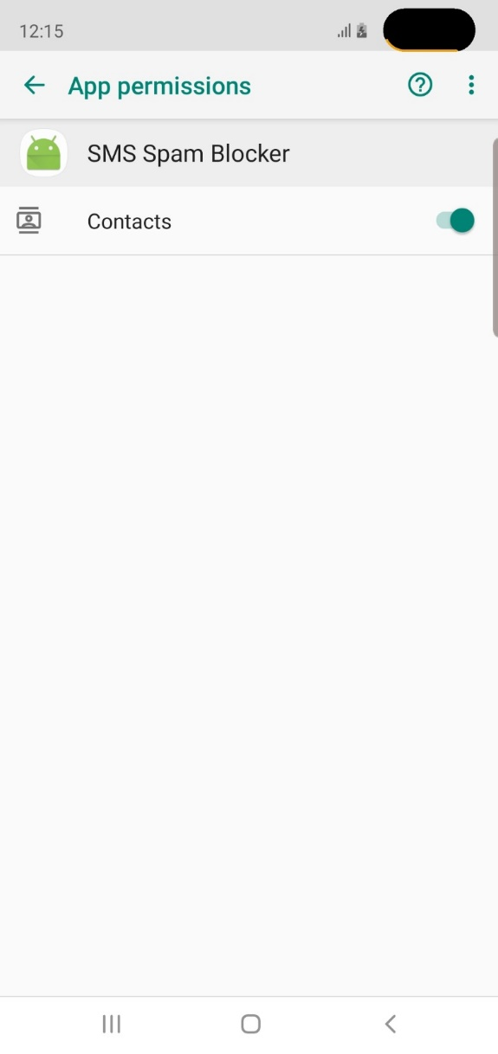

Slide 14
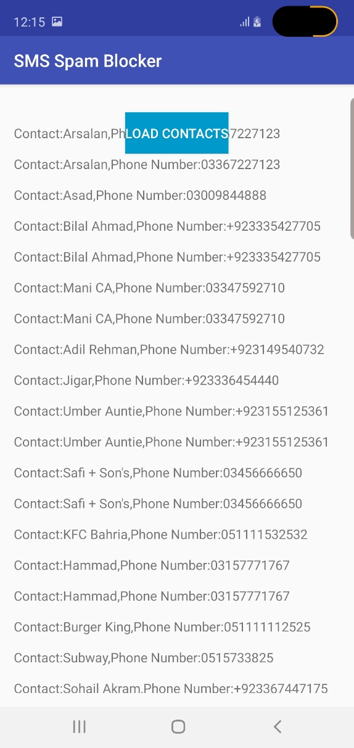

Slide 15
Thank You

